Slide 1
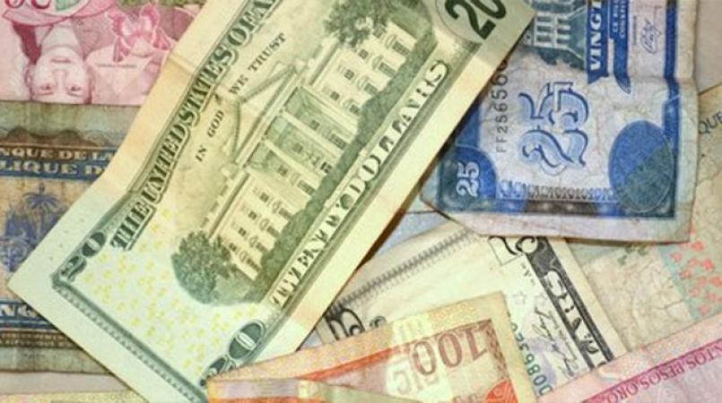
FORECASTING US-HTG EXCHANGE RATE IN HAITI
A MACHINE LEARNING APPROACH
By Grégory PINCHINAT © August 14, 2020

Slide 2

PLAN
INTRODUCTION
METHODOLOGY
DATA SOURCES
QUICK FACTS & FIGURES
EFFECT OF PUBLIC & ECONOMIC POLICIES?
IMPACT OF VARIOUS FACTORS
FORECASTING THE EXCHANGE RATE
COMPARISONS OF TWO FORECASTING MODELS
CONCLUSIONS & RECOMMENDATIONS
THANKS, ANNEXES & REFERENCES

Slide 3

INTRODUCTION
The Exchange Rate is unstable.
Constant worries about date of next spike and its amplitude.
First and major step to implement a solution: analyze time series and inform rational anticipations.

Slide 4

METHODOLOGY
Exchange Rate and most related factors are economic ⇨ Economics-based methodology
However a Data Science approach is used to implement a popular economic-type model of prediction known as VAR.
A similar study (Haiti: Selected Issues and Statistical Appendix, IMF, 2007) helped select traditional features that could explain the fluctuations of the Exchange Rate.

Slide 5


DATA
SOURCES: Haiti Open Data’s website, the IMF, the World Bank, Haiti’s Central Bank (BRH), Haiti’s Airport Administration (AAN) and the Census Bureau of the USA.
FEATURES: Exchange Rate (‘end_rate’), Inflation Rates (‘inf’), Received Remittances (‘rec_rem’), Haiti’s Exports (‘us_imp_ht’), Haiti’s imports (‘us_exp_ht’), Debarkments from incoming Regular International Flights (‘int_reg_deb’), Embarkments onboard outgoing Flights (‘int_reg_emb’).

Slide 6

SOME QUICK FACTS & FIGURES
Did you know?
The USA is the first and the main partner of Haiti.
We export the most to them, we import the most from them.
76% of Haiti’s Production is imputable to International Trade.
84% of Haiti’s Exports go to the USA.
20.7% of Haiti’s Imports are from the USA.
(World Bank, 2018)

Slide 7

THE EXCHANGE RATE HAS WORSENED DURING THE LAST THREE YEARS
The Effect of Public and Economic Policies?
Under Martelly and Evans Paul, Exchange Rate increased by 28.57% from April to December 2015 (8 months)
2 years later, the increase was of 6.35% only, from the period of elections to Pres. Jovenel Moise’s first 10 months in power.
From January 2018 to today, the exchange rates increased by 79% (2.5 years).
Jan 2014 – Apr 2015 : Exchange Rate -49G/1U$
Before December 2015 : Exchange Rate -63G/1U$
Before December 2017: Exchange Rate -67G/1U$
Jan 2018 – Nowadays: from 67+ G to 120+ G/1U$

Slide 8

Now, let’s see how some FACTORS of the ECONOMY and other factors capturing HUMAN ACTIVITY happen to influence the Exchange Rates!

Slide 9
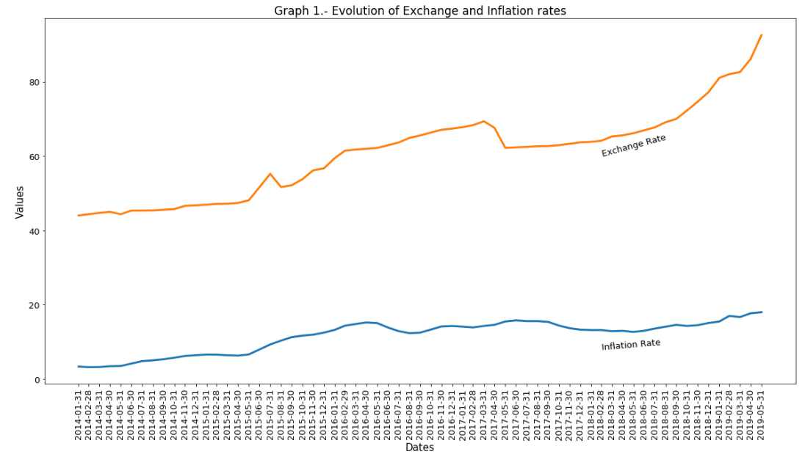
INFLATION
The Exchange rate dramatically increased from around August 2015 thru April 2017. Then from May 2017 to date, it kept on growing exponentially.
As Graph 1 shows it: An increase in the Exchange rate is almost always accompanied with a similar increase in the Inflation Rates, and vice versa.

Slide 10
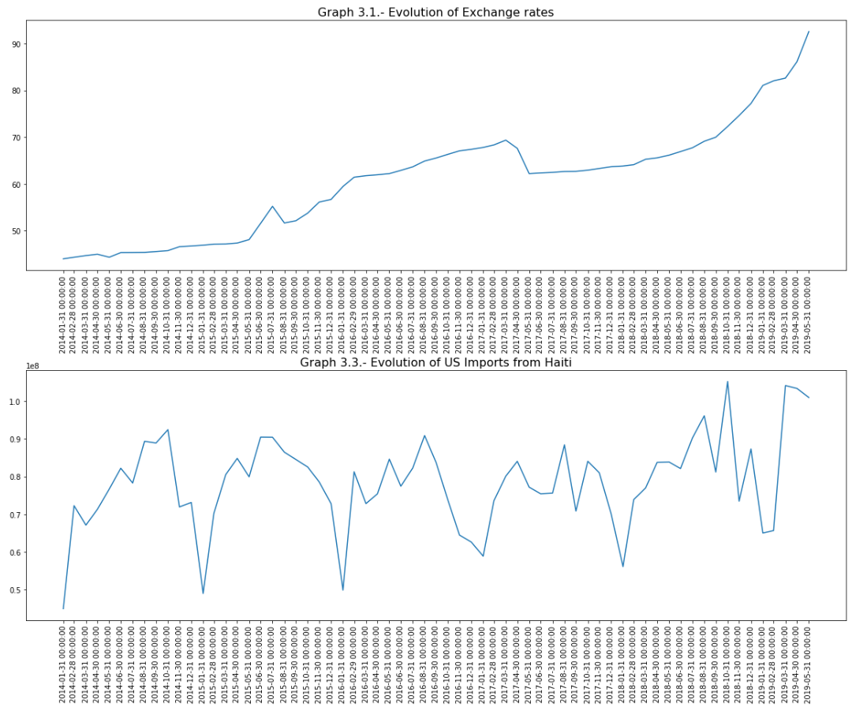
EXPORTS
TO THE USA
Exports bring dollars in the economy, but as Graph 3.3 shows, they are seasonal: The Americans always buy way less Haitian products in January than in any other month of the year.
Dollars earned from exporting to the USA might be mainly financing imports from the USA, instead of financing National Production.

Slide 11
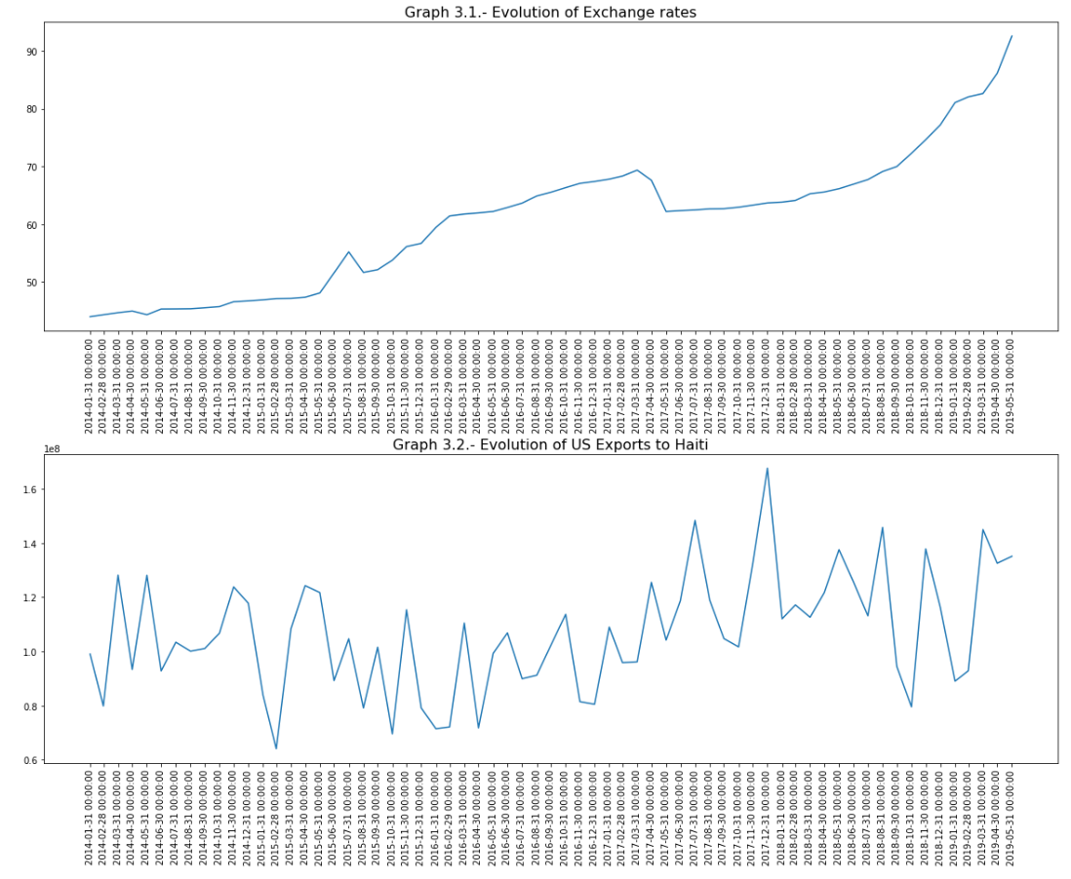
IMPORTS
FROM THE USA
Among other dates alike, in December 2017, the Imports hit a historical high (U$ 160M), but the Exchange Rate did not increase accordingly in the preceding months.
The Exchange rate behaving so weirdly may give the economists reasons to believe that some major agents in the economy might be massively hoarding the US currency, or using other artificial strategies to override the market forces.

Slide 12
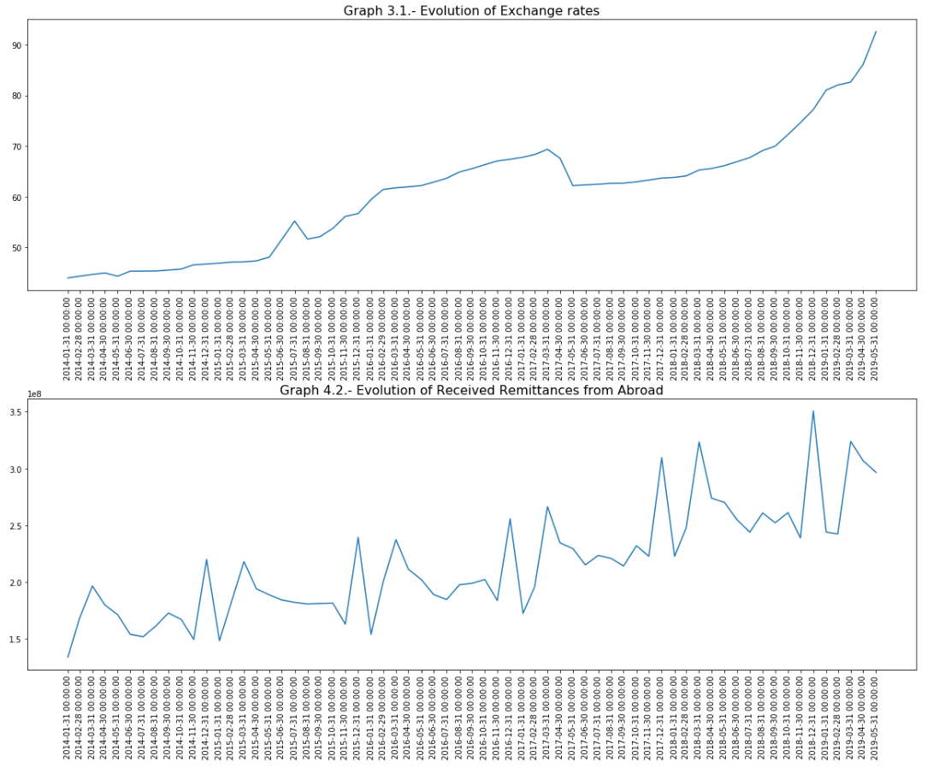
REMITTANCES FROM ABROAD
Remittances are seasonal:
They may spike up around U$ 260M in March and around U$ 275M in December;
And brutally drop around 179M in January, 192M in November.
Graph 4.2 suggest they might be helping fight against inflation, but they tend to evolve like the inflation and the exchange rates on the long run.

Slide 13
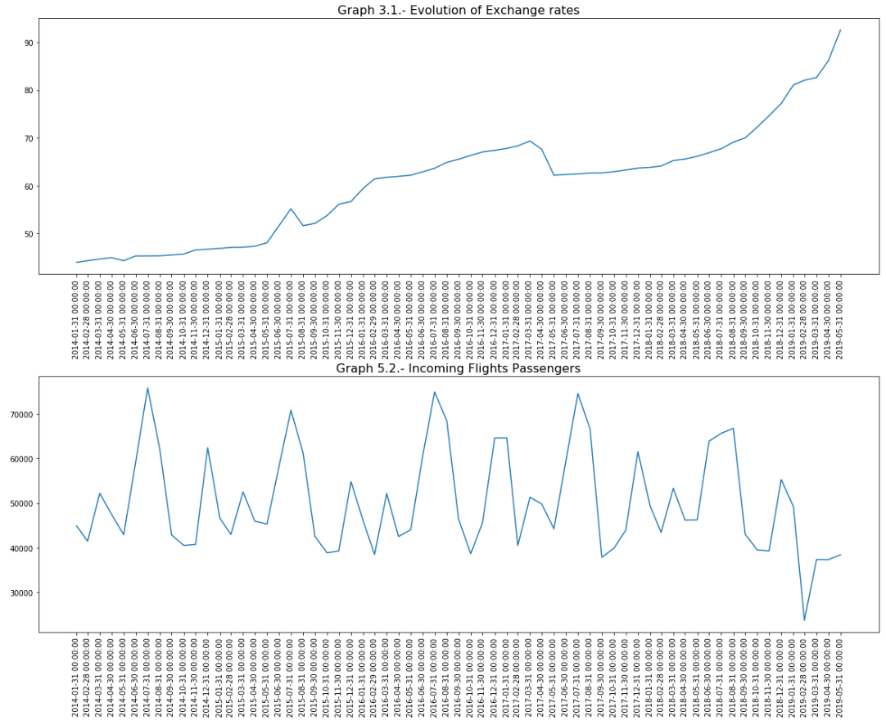
DEBARKMENTS
Graph 5.2 shows a spike every year in July, with around 72k passengers debarking from regular international flights.
In comparison, the average over the whole period under study is of 50k.
Every time the Rates spike, there are less and less passengers landing in the Toussaint Louverture International airport.

Slide 14
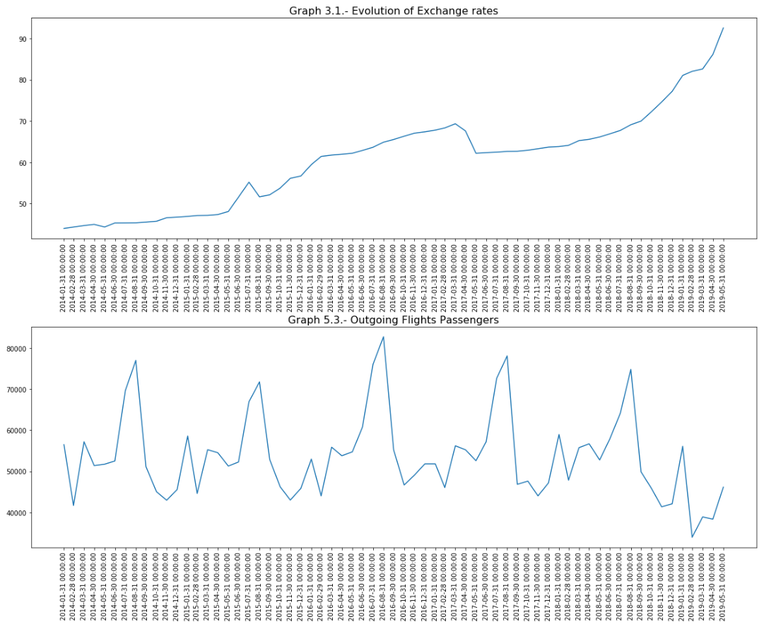
EMBARKMENTS
Graph 5.3 shows a spike every year in August, with around 76k passengers leaving the country in average froaboard regular international flights. In comparison, the average over the whole period of study is 54k.
The above also means most of those passengers might be those who came in July who actually leave in August.

Slide 15
FORECASTING THE EXCHANGE RATES!

Slide 16


TWO MODELS HAVE BEEN ESTIMATED
Model 1 accounts for all the factors analyzed before, and studies their evolution from January 2014 thru Feburary 2019, whereas in Model 2, the Flights Data have been dropped.
With Model 2, we wanted to try another model with less factors but more recent observations to see how well it fares compared to Model 1.

Slide 17
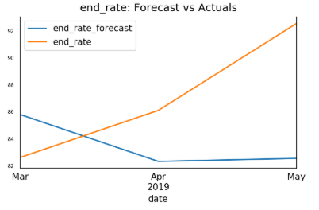
TESTING MODEL 1
The matrix of variables account for up to 4 lags: the value of each factor during the last 4 months are being used by the machine in order to learn how the Exchange Rate has been evolving and predict what value it would more likely be expected to have in the next month.
When tested over March thru May 2019, Model 1 gives precise prediction on the first two months for the Exchange Rate, and fails at predicting the other factors.
Mean absolute percent error: 6.35%, root mean square error: 6.43.

Slide 18
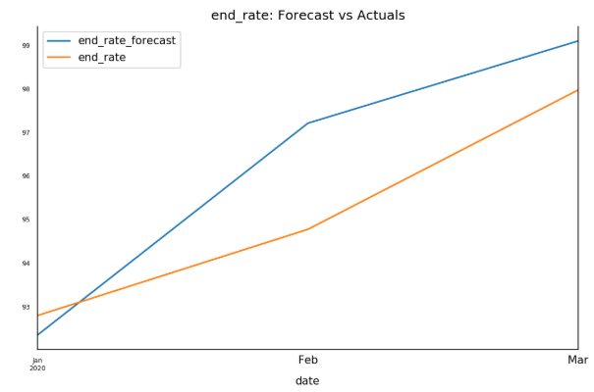
TESTING MODEL 2
The matrix of variables account for up to 12 lags.
When tested over January thru March 2019, Model 2 gives slightly better and more precise prediction for the Exchange Rate, and doesn’t fare any better than Model 1 at predicting the other factors.
Mean absolute percent error: 1.40% ; root mean square error: 1.57. The lesser the error, the better the model predicts.

Slide 19
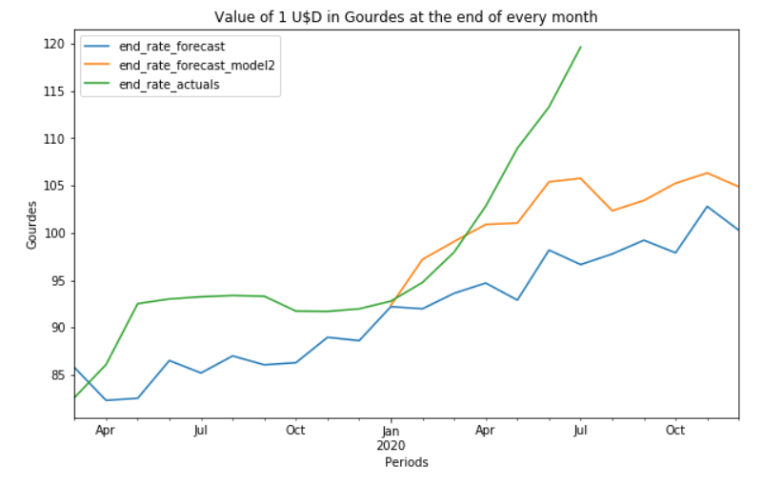
COMPARISON OF THE EXCHANGE RATE MODELS
OVER THEIR RESPECTIVE SPAN OF PREDICTION
Both models systematically predict Exchange Rates lesser than the actual values. Which, again would sustain the hypothesis that other factors, probably under the control of a group of economic agents, might be influencing the Exchange rates out of the economic sphere.
However the curve of the second model tends to be closer to the actual values than that of the first model. Which would make us trust the second model more than the first.

Slide 20
CONLUSION
The problem ⇨ Exchange Rate fluctuating uncontrollably.
Economic factors + Non-economic Factors ⇨ 2 models.
Meddling with the market forces? ⇨ Not good!
The fact that even with all the economic information, both models are not faring as well as expected might be an indication that some major economic agents might be interfering with the market forces in order to influence the dollars prices in order to maximize their personal advantages or their own corporate profit.

Slide 21
RECOMMENDATIONS TO THE PRIVATE SECTOR
Acknowledge they are part of a system (“The Haitian Economy”) which, on the long run, is bound to fail and bring them bankruptcy if they’re not interested in understanding its flaws properly in order to fix it.
Data Scientists, Statisticians and Economists have all the tools to help you understand your business and your eco-system better than you think you already do. So you guys should be definitely more open and transparent when it comes to sharing your data with the public, namely with independent Data Scientist and/or Statistician willing to study them thoroughly.
What if Haitian businesses displayed their updated prices and updated product information on their website like Amazon, or any other serious company does? It would only attract more customers, allow them to make quick price comparisons and rush to buy your products provided they’re better! All you have to do is make sure they’re of good quality.

Slide 22
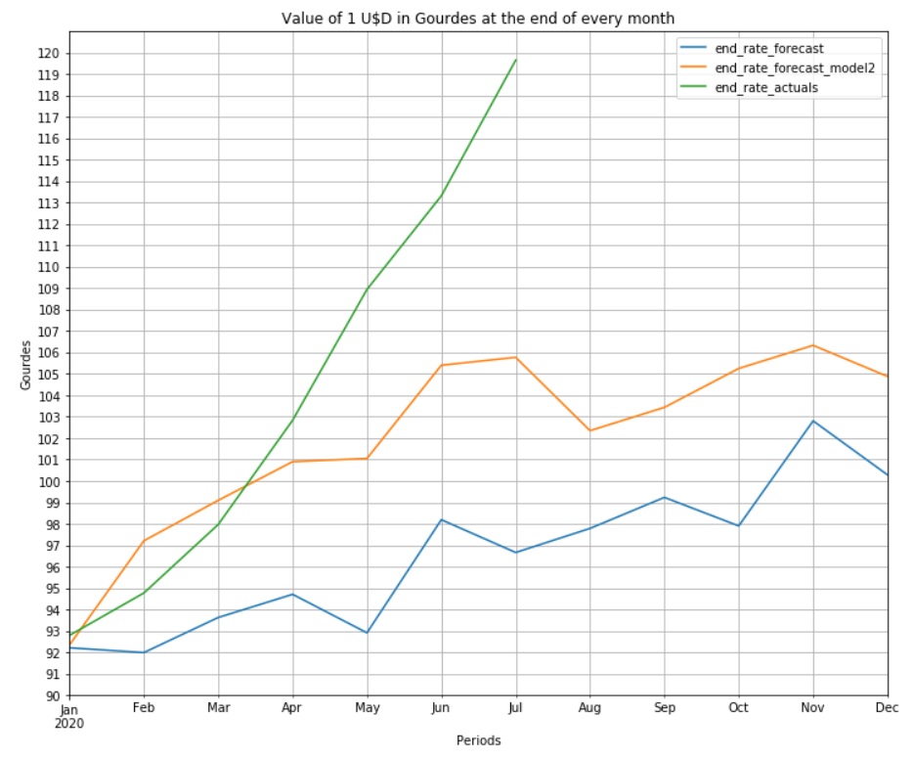
RECOMMENDATIONS TO THE HAITIAN GOVERNMENT
We’re expecting a drop in the rates at the end of August 2020, according to Model 2, but the actual rate might still keep on its exponential trend instead, if non-economic factors are still having a significant influence.
Also, the State, namely the BRH, the Ministère du Commerce, the Ministère des Finances, the IHSI, the public administration as a whole, could start monitoring social and commercial variables more closely, and accordingly implement more strict regulations on the banks, the Money Transfer companies and the International Trade in Haiti.
We’re living in a capitalist country, but complete laissez-faire won’t be advantageous to any of us, it could completely collapse our economy and generate civil conflicts, which are not optimal for investing or making profits. The State should at least send strong signals that give good reasons to cooperate on this issue.

Slide 23
RECOMMENDATIONS TO THE AVERAGE CONSUMERS, YOUNG ENTREPRENEURS & SMEs
These recommendations are meant to be provisory and palliative, until better alternatives are proposed by major economic agents such as the Government, namely the BRH, and the commercial banks:
Instead of saving, start hoarding: This might create inflation on the long run, and might be dangerous if anybody knows how much you are hoarding, but this is the only way your assets won’t lose value over time.
You may acquire bonds from the BRH as well, but we wouldn’t advise it: given the exponential trend the actual Exchange Rates are spiking on, if nothing is done to fix this, your profits in terms of interest rate might lose value over time quite quickly.
Since the lower-classes, namely the Masses and the Middle-Class evolve mostly in the informal sector, why not get into the Exchange rate business by selling or lending dollars a bit lesser than the price of the commercial banks? New Money Transfer businesses might as well compete those that already exist.

Slide 24

MERCI
Grégory PINCHINAT
Data Scientist
Statistician / Economist
gregpinchy@gmail.com
Github link to this project:
https://github.com/gregpinchy/creative-capstone-AA.git
1
D’AVOIR
SUIVI!

